Slide 1
A very brief introduction to R
- Matthew Keller
Some material cribbed from: UCLA Academic Technology Services Technical Report Series (by Patrick Burns) and presentations (found online) by Bioconductor, Wolfgang Huber and Hung Chen, & various Harry Potter websites

Slide 2

R programming language is a lot like magic... except instead of spells you have functions.
R, And the Rise of the Best Software Money Can’t Buy

Slide 3


=
muggle
SPSS and SAS users are like muggles. They are limited in their ability to change their environment. They have to rely on algorithms that have been developed for them. The way they approach a problem is constrained by how SAS/SPSS employed programmers thought to approach them. And they have to pay money to use these constraining algorithms.

Slide 4
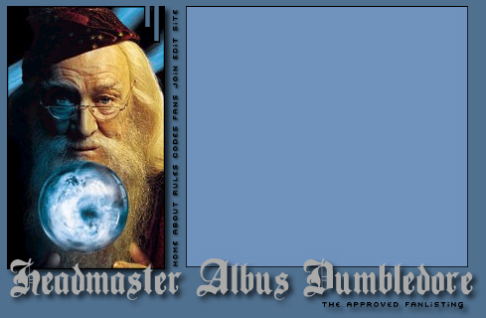

=
wizard
R users are like wizards. They can rely on functions (spells) that have been developed for them by statistical researchers, but they can also create their own. They don’t have to pay for the use of them, and once experienced enough (like Dumbledore), they are almost unlimited in their ability to change their environment.

Slide 5
History of R
S: language for data analysis developed at Bell Labs circa 1976
Licensed by AT&T/Lucent to Insightful Corp. Product name: S-plus.
R: initially written & released as an open source software by Ross Ihaka and Robert Gentleman at U Auckland during 90s (R plays on name “S”)
Since 1997: international R-core team ~15 people & 1000s of code writers and statisticians happy to share their libraries! AWESOME!

Slide 6
“Open source”... that just means I don’t have to pay for it, right?
No. Much more:
  Provides full access to algorithms and their implementation
  Gives you the ability to fix bugs and extend software
  Provides a forum allowing researchers to explore and expand the methods used to analyze data
  Is the product of 1000s of leading experts in the fields they know best. It is CUTTING EDGE.
  Ensures that scientists around the world - and not just ones in rich countries - are the co-owners to the software tools needed to carry out research
  Promotes reproducible research by providing open and accessible tools
  Most of R is written in… R! This makes it quite easy to see what functions are actually doing.
5

Slide 7
What is it?
R is an interpreted computer language.
  Most user-visible functions are written in R itself, calling upon a smaller set of internal primitives.
  It is possible to interface procedures written in C, C+, or FORTRAN languages for efficiency, and to write additional primitives.
  System commands can be called from within R
R is used for data manipulation, statistics, and graphics. It is made up of:
  operators (+ - <- * %*% …) for calculations on arrays & matrices
  large, coherent, integrated collection of functions
  facilities for making unlimited types of publication quality graphics
  user written functions & sets of functions (packages); 800+ contributed packages so far & growing

Slide 8
R
Advantages Disadvantages
Fast and free.
State of the art: Statistical researchers provide their methods as R packages. SPSS and SAS are years behind R!
2nd only to MATLAB for graphics.
Mx, WinBugs, and other programs use or will use R.
Active user community
Excellent for simulation, programming, computer intensive analyses, etc.
Forces you to think about your analysis.
Interfaces with database storage software (SQL)

Slide 9
R
Advantages Disadvantages
Fast and free.
State of the art: Statistical researchers provide their methods as R packages. SPSS and SAS are years behind R!
2nd only to MATLAB for graphics.
Mx, WinBugs, and other programs use or will use R.
Active user community
Excellent for simulation, programming, computer intensive analyses, etc.
Forces you to think about your analysis.
Interfaces with database storage software (SQL)
Not user friendly @ start - steep learning curve, minimal GUI.
No commercial support; figuring out correct methods or how to use a function on your own can be frustrating.
Easy to make mistakes and not know.
Working with large datasets is limited by RAM
Data prep & cleaning can be messier & more mistake prone in R vs. SPSS or SAS
Some users complain about hostility on the R listserve

Slide 10

Learning R....

Slide 11

R-help listserve....

Slide 12
Don’t expect R to be like SAS/SPSS/Stata/etc…
Here’s a synopsis of one person’s story. He used SAS and, being a fan of open-source, attempted to learn R. He became frustrated with R and gave up. When he had a simple problem that he couldn’t do in SAS, he quickly solved it with R. Then over about a month he became comfortable with R from consistent study of it. In hindsight he thinks that the initial problem was that he hadn’t changed his way of thinking to match R’s approach, and he wanted to master R immediately. --Patrick Burns, UCLA Statistical Consultant

Slide 13
Two personal examples…
1. Run Mx (SEM program) ML factor analysis script from within R
Grep the Mx output and pull it into R in form of a matrix & p-value
If p-value <.05, run another Mx script. Otherwise, keep old matrix
Get distributions of the columns of these matrices from 10000 runs
2. Profile analysis (within-subject MANOVA) on dataset that included twins - violation of independence assumption!
So we needed to permute the independent variable within families for one analysis and within individuals for another.
Do this 10000 times and save results after each to get valid p-values

Slide 14
R Commercial packages
Many different datasets (and other “objects”) available at same time
Datasets can be of any dimension
Functions can be modified
Experience is interactive-you program until you get exactly what you want
One stop shopping - almost every analytical tool you can think of is available
R is free and will continue to exist. Nothing can make it go away, its price will never increase.
One datasets available at a given time
Datasets are rectangular
Functions are proprietary
Experience is passive-you choose an analysis and they give you everything they think you need
Tend to be have limited scope, forcing you to learn additional programs; extra options cost more and/or require you to learn a different language (e.g., SPSS Macros)
They cost money. There is no guarantee they will continue to exist, but if they do, you can bet that their prices will always increase

Slide 15
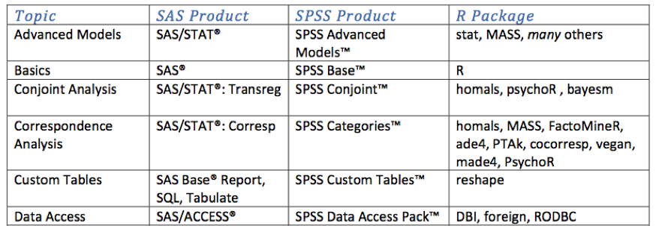
R vs SAS/SPSS
For the full comparison chart, see http://rforsasandspssusers.com/ by Bob Muenchen

Slide 16
There are over 800 add-on packages
(http://cran.r-project.org/src/contrib/PACKAGES.html)
This is an enormous advantage - new techniques available without delay, and they can be performed using the R language you already know.
Allows you to build a customized statistical program suited to your own needs.
Downside = as the number of packages grows, it is becoming difficult to choose the best package for your needs, & QC is an issue.

Slide 17
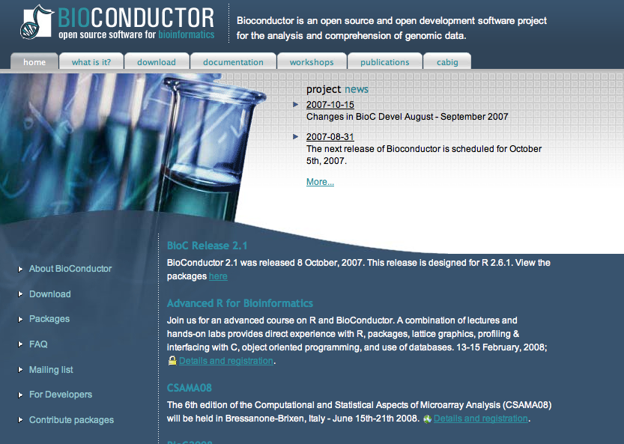
A particular R strength: genetics
Bioconductor is a suite of additional functions and some 200 packages dedicated to analysis, visualization, and management of genetic data
Much more functionality than software released by Affy or Illumina

Slide 18
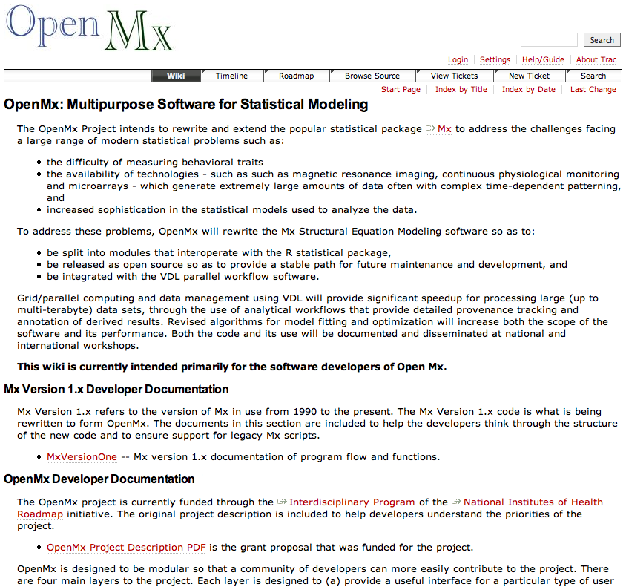
An R weakness
Structural Equation Modeling - the sem package is quite limited.
But this will
not be a weakness
for long…

Slide 19
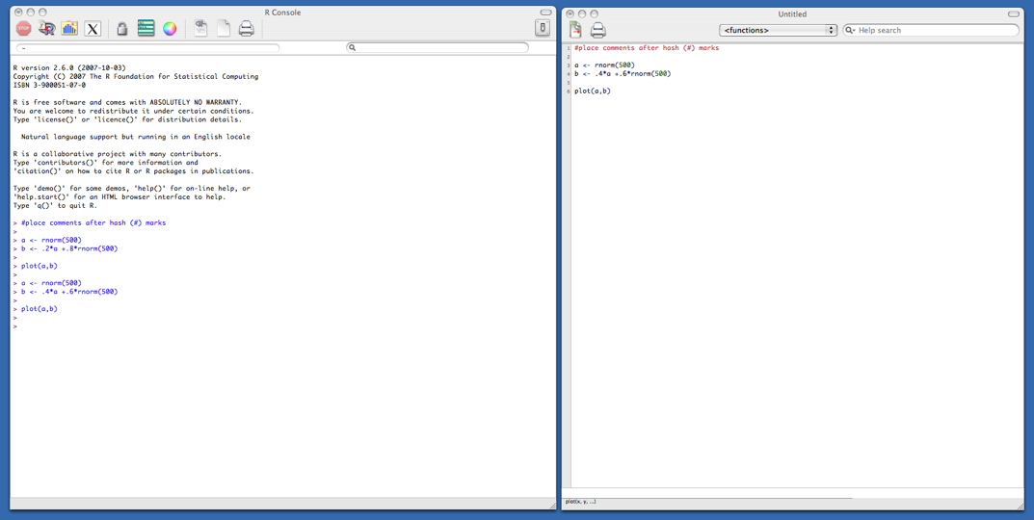
Typical R session
Start up R via the GUI or favorite text editor
Two windows:
  1+ new or existing scripts (text files) - these will be saved
  Terminal – output & temporary input - usually unsaved

Slide 20
Typical R session
R sessions are interactive
Write small bits of code here and run it

Slide 21
Typical R session
R sessions are interactive
Write small bits of code here and run it
Output appears here. Did you get what you wanted?

Slide 22
Typical R session
R sessions are interactive
Output appears here. Did you get what you wanted?
Adjust your syntax here depending on this answer.

Slide 23
Typical R session
R sessions are interactive

Slide 24
Typical R session
R sessions are interactive
At end, all you need to do is save your script file(s) - which can easily be rerun later.

Slide 25
R Objects
Almost all things in R – functions, datasets, results, etc. – are OBJECTS.
  (graphics are written out and are not stored as objects)
Script can be thought of as a way to make objects. Your goal is usually to write a script that, by its end, has created the objects (e.g., statistical results) and graphics you need.
Objects are classified by two criteria:
  MODE: how objects are stored in R - character, numeric, logical, factor, list, & function
  CLASS: how objects are treated by functions (important to know!) - [vector], matrix, array, data.frame, & hundreds of special classes created by specific functions

Slide 26
R Objects
x1 x2 x3 x4 x5 x6
1
2
3
4
5
6
7
8
Z <-

Slide 27
R Objects
x1 x2 x3 x4 x5 x6
1
2
3
4
5
6
7
8
The MODE of Z is determined automatically by the types of things stored in Z – numbers, characters, etc. If it is a mix, mode = list.

Slide 28
R Objects
x1 x2 x3 x4 x5 x6
The CLASS of Z is either set by default depending, on how it was created, or is explicitly set by user. You can check the objects’ class and change it. It determines how functions deal with Z.
1
2
3
4
5
6
7
8

Slide 29
Learning R
Check out the course wikisite - lots of good manuals & links
Read through the CRAN website
Use http://www.rseek.org/ instead of google
Know your objects’ classes: class(x) or info(x)
Because R is interactive, errors are your friends!
?lm gives you help on lm function. Reading help files can be very… helpful
MOST IMPORTANT - the more time you spend using R, the more comfortable you become with it. After doing your first real project in R, you won’t look back. I promise.

Slide 30
Things to do now
Open a dedicated gmail account & subscribe to R-help mailing list (https://stat.ethz.ch/mailman/listinfo/r-help). Once you have done this, email matthew.c.keller@gmail.com. I will create an email group and send out a notice about the group’s name. Thereafter, please: a) have this email account open whenever doing R (or more often if you want), and b) ask questions to the group as they arise. If you know an answer or can guess at it, fire away! Also, keep an eye on the list-serve queries. It’s a great way to learn R!
Create your own personalized script library. When you learn how to do something, place the syntax in your script library. Keep it organized. Turn in your updated script library with each homework.

Slide 31

Recommended Book
An R and S-PLUS Companion to Applied Regression: An excellent overview of R, not just regression in R. Highly recommended. Many of the HWs we will do were inspired by Fox’s book. Books aren’t required for this course, but if you are the type of person who likes to have a book, buy this one. $56 at Amazon.

Slide 32
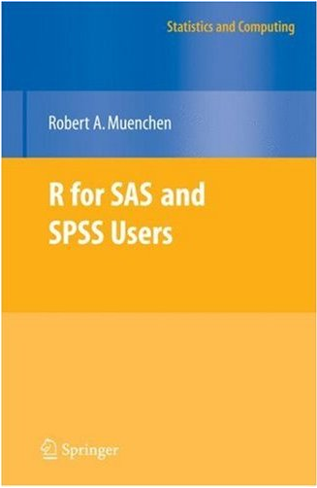
2nd Recommended Book
R for SAS and SPSS Users: Meunchen’s book is geared to people who already know SAS or SPSS and want to learn R. If that describes you, you might consider buying this book. I haven’t read it but it receives good reviews. $60 at Amazon.

Slide 33
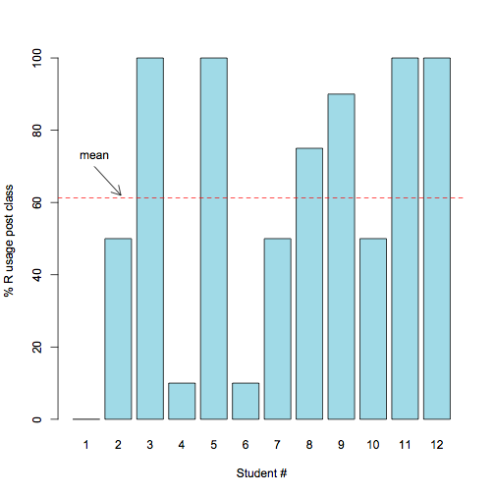
Success of this course from Spring 2008, judged by self-reported % usage of R among all statistical programs

Slide 34
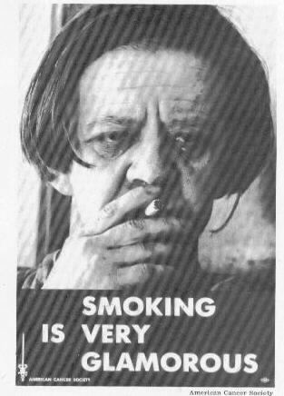
Final Words of Warning
“Using R is a bit akin to smoking. The beginning is difficult, one may get headaches and even gag the first few times. But in the long run,it becomes pleasurable and even addictive. Yet, deep down, for those willing to be honest, there is something not fully healthy in it.” --Francois Pinard
R

Slide 35
Next three classes
Jan 23: 1) Have R installed
2) Go over HW
3) Go over R basics and the reading, writing, and manipulation of data
Jan 30: 1) Go over HW
2) Go over descriptive stats, ANOVA & regression
Feb 6: 1) Go over HW
2) Go over an intro to graphics

